Slide 1
Introduction to RStudio software
By [UNISALENTO]

Slide 2
Index
1
2
3
Unit 1: Introduction
history The computing environment Analysis Techniques Community
Unit 2: The R Software
How to install R What does R look like?
Unit 3: RStudio
Let's explore RStudio Creating a Project Notebook & Scripts Statistics in R Graphs in R

Slide 3
Unit 1: Introduction
Section 1: a brief history
Project R was born in the statistics department of the University of Auckland, New Zealand;
The founders of the project are Robert Gentleman and Ross Ihaka, now associate professors;
The project started in 1991, but the first release was in 1996;
R software is now considered the most powerful statistical computing language in the world;

Slide 4
Unit 1: Introduction
Section 2: The Computing Environment
Cross-platform (Windows, MacOS, Linux);
Open-source (software, manuals, reference cards, all downloadable from the www.r-project.org website);
It has numerous integrated tools for data analysis;
Allows you to implement matrix calculus;
Easily manipulated and useful for data storage;
The term environment is intended to distinguish R as a fully planned and coherent system, rather than a collection of extremely specific and inflexible tools..

Slide 5
Unit 1: Introduction
Section 3: Statistical Analysis Techniques
Most of the statistical techniques, from the most classic to the most recent, have been implemented in the R environment.
Only some of these are integrated into the basic environment, many others are provided in the form of packages, through the family of websites called CRAN (Comprehensive R Archive Network).

Slide 6
Unit 1: Introduction
Section 4: Community
A community of over 2 million users and developers provides time and technical expertise to maintain, support and develop the R language and environment, tools and infrastructure.
At the heart of the community, the R Core group, of about 20 members, takes care of the maintenance and guides the evolution of R.
The official public structure is provided by the R foundation, a non-profit organization that ensures the financial stability of R-project and administers the copyright of the software and documentation.

Slide 7
Unit 2: Software R
Section 1: How to install R software
From the site https://www.r-project.org/
Click Download R
Choose the CRAN you want (the physical place from which to download the software)
Choose the operating system on which to download the program (Windows, Linux,
MacO)
Click install R for the first time
Start the download

Slide 8
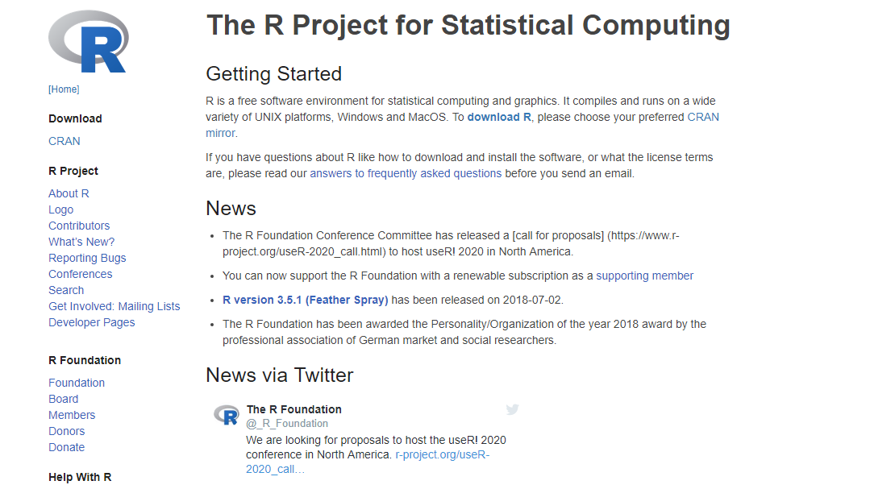

Slide 9
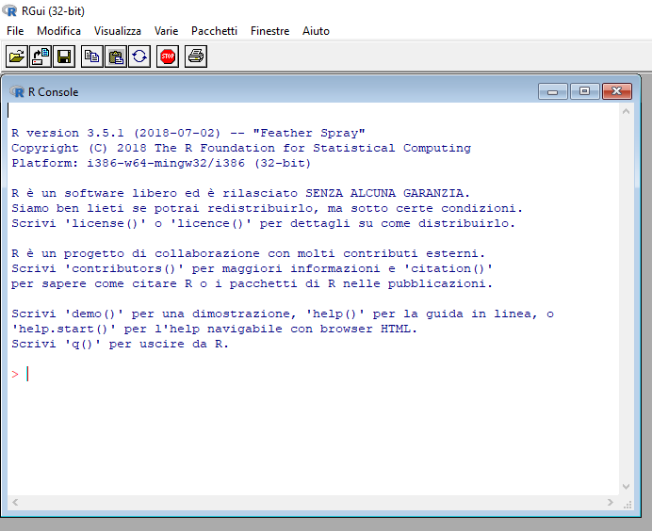
Unit 2: Software R
Section 2: What R looks like

Slide 10
Unit 3: RStudio
Section 1: Let's explore RStudio
The most commonly used and most accessible interface is RStudio, downloadable from the https://www.rstudio.com/
RStudio uses a user-friendly interface to facilitate its use;
Click on Download (RStudio);
Choose the free version;
Start the download;

Slide 11
Unit 3: RStudio
Section 1: Let's explore RStudio
Integrated Development Environment (IDE) for R;
The RStudio working environment consists of 4 windows:
Code window (write//execute scripts) Console (Command Line//Output View) Object window (object list//command history) Package window//charts//help

Slide 12
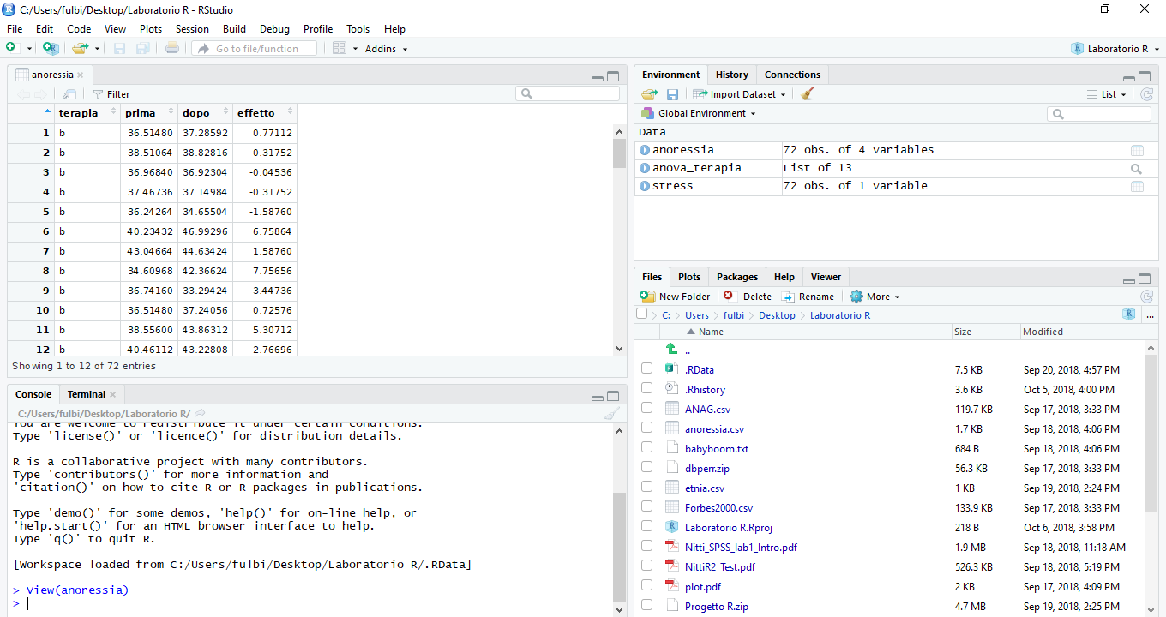
Unit 3: RStudio
Section 1: Let's explore RStudio
Code window: run scripts, view data structures
Workspace: View Available Data Structures
Multitab window: graphs, packages, help on installed functions
Console: Run scripts and view output

Slide 13
Unit 3: RStudio
Section 1: Let's explore Rstudio: Multi Tab Window
Packages: allows you to download packages that allow you to perform statistical analysis, such as Analysis in Main Components.
Example: click Install and install the ggplot2 package
Help: allows you to have the description of the package.
Example: Type ggplot2

Slide 14
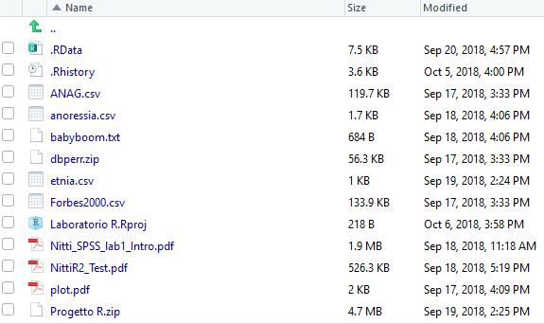
Unit 3: RStudio
Section 1: Let's explore Rstudio: Multi Tab Window
Files: allows you to quickly access saved files after creating an R project

Slide 15
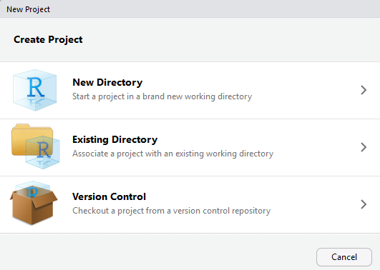
Unit 3: RStudio
Section 2: Creating a Project
With RStudio you can create a project in order to define the working directory, have all the data, packages and codes inside.
To create a new project, go to the menu at the top left and select File -> New Project

Slide 16
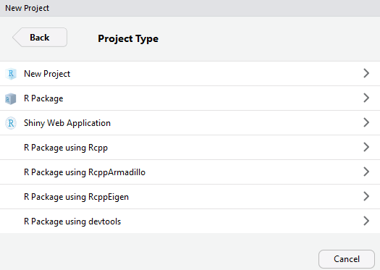
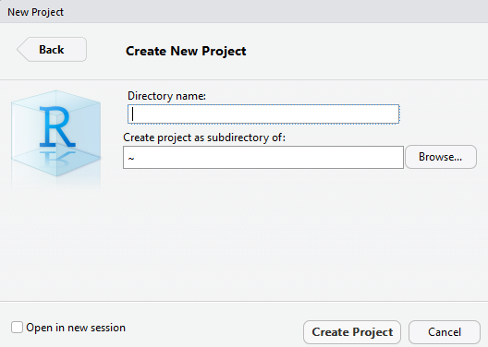
Unit 3: RStudio
Section 2: Creating a Project

Slide 17
Unit 3: RStudio
Section 2: Creating a Project
Getting Started: Loading Data
R can read different types of data (TXT, CSV, XLS, XLSX, SPSS, STATA), but the simplest and most immediate way is the CSV format (Comma Separated Value).
To upload a CSV file select Environment from the menu on the top right -> Import Dataset -> From Text File, Then select the directory and file.

Slide 18
Unit 3: RStudio
Section 3: R Notebook & R Script
They allow you to keep track of the codes and analyzes carried out within the R project and save them on the PC for further consultations.

Slide 19
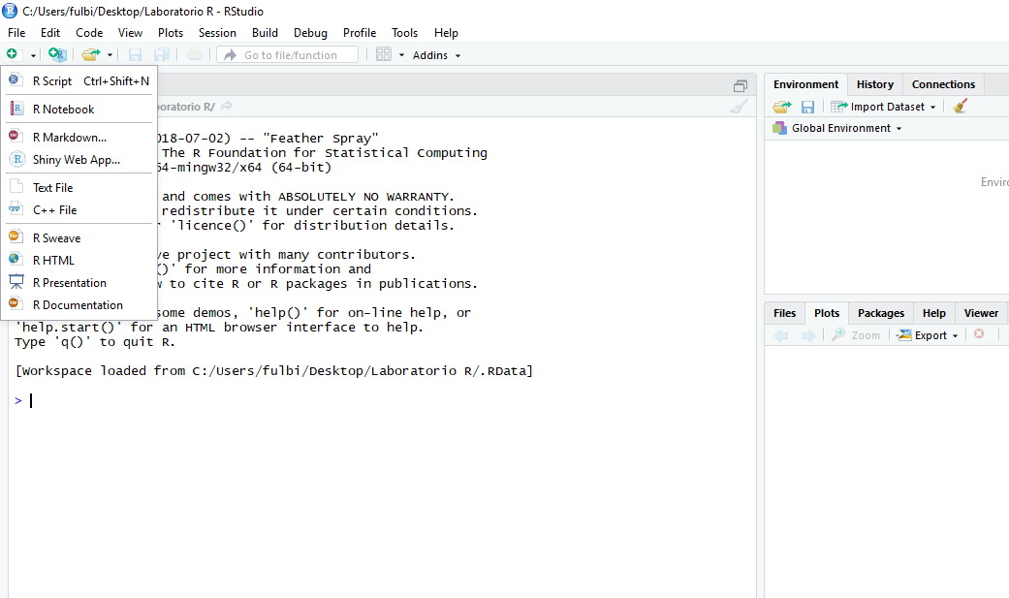

Slide 20
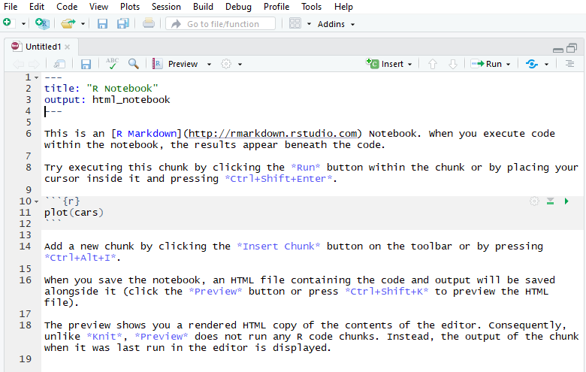
R Notebook Allows you to create a report of a project by entering all the steps, operations and graphs created.

Slide 21
R Notebook: The commands must be inserted inside special chunk (ALT + CTRL + I), the descriptions out
Allow you to Process Commands
Chunk
Command description

Slide 22
Save R Notebook
Preview R Notebook

Slide 23
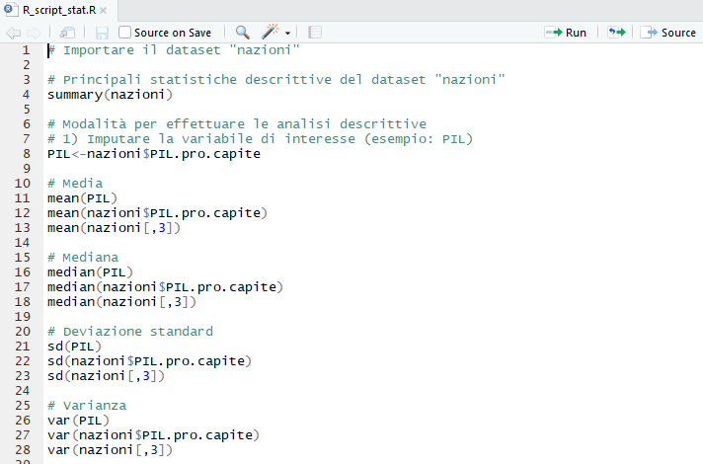
R Script:

Slide 24
R Script:
Create a file where to insert all the codes useful for the appropriate analysis Descriptions between # are not considered by R as code to be implemented The Top Right Run button allows you to process codes
Codes can be selected all together and processed simultaneously

Slide 25
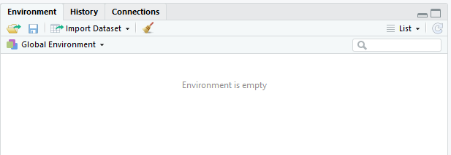
Unit 3: RStudio
Section 4: Loading a Dataset
From Text File, You can select the directory and file

Slide 26
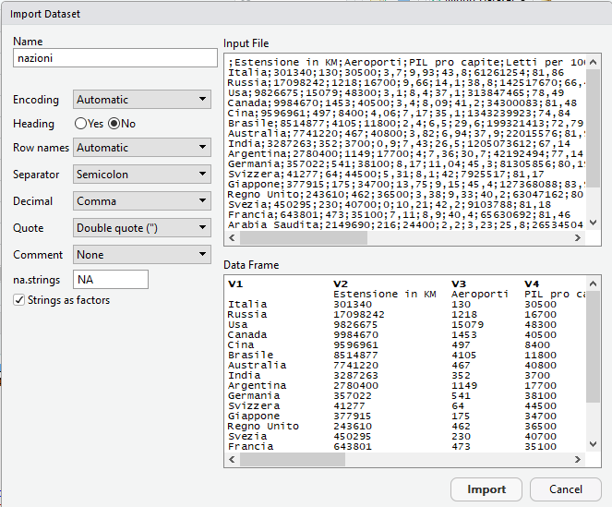

Slide 27
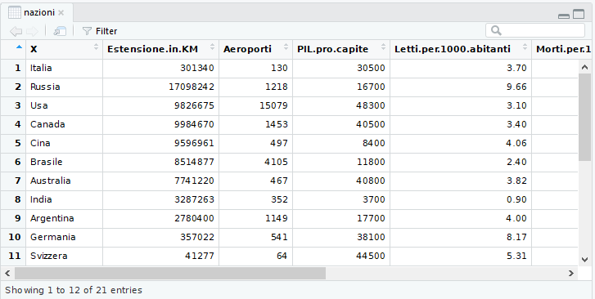
RESULT

Slide 28
Unit 3: RStudio
Section 5: Descriptive Statistics "Summary"
A first exploration of the distribution of the variables contained in the countries dataset is obtained through the summary command, which must be inserted in the window called Console. The command structure is:
summary(name dataset / or name variable)

Slide 29
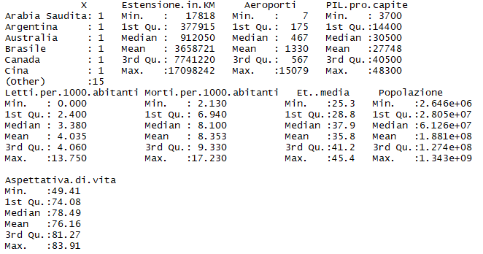
For each variable, the values of:
Minimum 1st Quartile Median Average 3rd Quartile Maximum

Slide 30
Unit 3: RStudio
Section 5: Descriptive Statistics: Other Descriptive Statistics
You can assign a name to each column of interest: PIL<-nazioni$PIL.pro.capite
The main synthesis indices for quantitative variables are:
Media: mean(PIL) or mean(nazioni$PIL.pro.capite) or mean(nazioni[,3])
Varianza: var(PIL) or var(nazioni$PIL.pro.capite) or var(nazioni[,3])
SQM (Standard deviation): sd(PIL) or (nazioni$PIL.pro.capite) or sd(nazioni[,3])

Slide 31
Unit 3: RStudio
Section 6 : Graphs in R (Plot)
BOX-PLOT:
The box-plot describes a quantitative variable through the graphical representation of the minimum, maximum, quartiles and median.
boxplot(nazioni$PIL.pro.capite, main = "Box-Plot del PIL pro capite")
or
boxplot (nazioni[,4], main = "Box-Plot del PIL pro capite")
or
boxplot(PIL, main = "Box-plot del PIL pro capite")

Slide 32
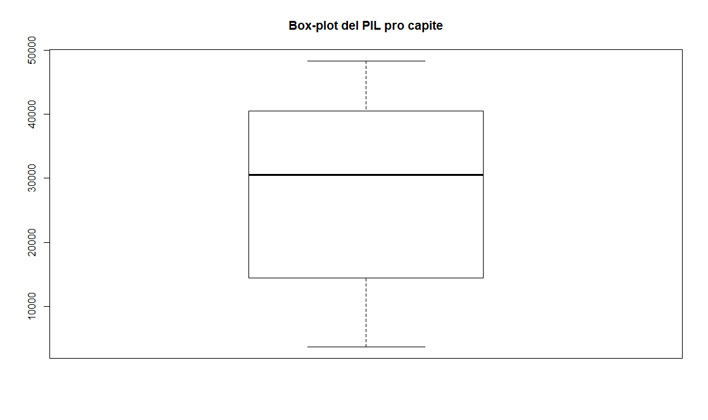

Slide 33
Maximum value
3rd Quartile
Median
Asymmetric distribution
1st Quartile
THERE ARE NO OUTLIERS
Minimum value

Slide 34
Unit 3: RStudio
Section 6 : Graphs in R (Plot)
SCATTER DIAGRAM:
Performing an exploratory analysis on the type of relationship between two variables
Example from the dataset: analyze the relationship between average age and life expectancy. Is there a relationship?
1) Name variables of interest eta<-nazioni$Et..media
asp<-nazioni$Aspettativa.di.vita

Slide 35
Unit 3: RStudio
Section 6 : Graphs in R (Plot)
SCATTER DIAGRAM:
The command to prepare the scatterplot is:
plot(asp, eta, xlab="Aspettativa di vita", ylab="Età media")

Slide 36
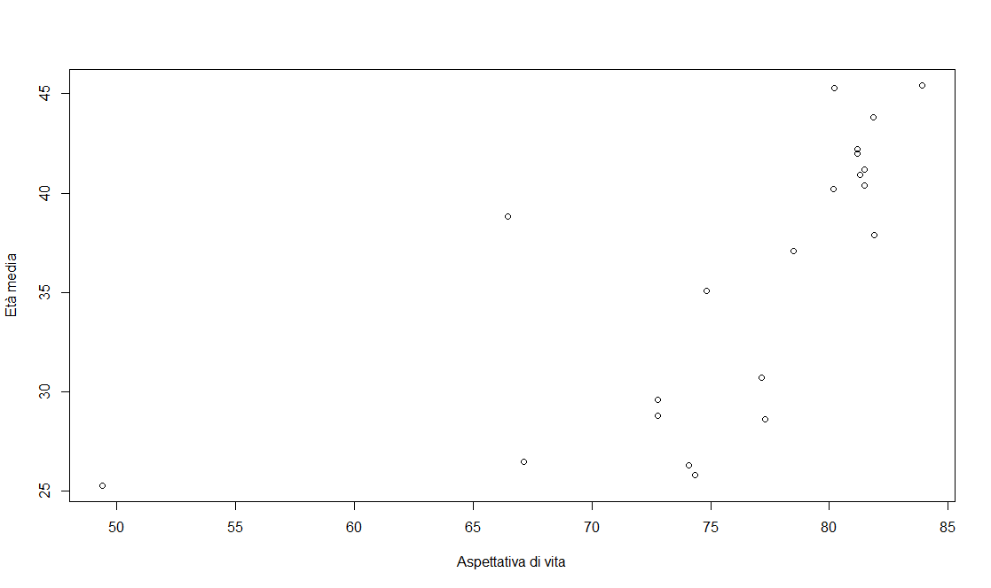

Slide 37
Unit 3: RStudio
Section 6 : Graphs in R (Plot)
SCATTER DIAGRAM: What can you say?
From the scatterplot there appears to be a relationship between the variables Life expectancy and Average age.
Specifically, as the average age increases, life expectancy increases.
Correlation analysis: cor(asp,eta) = 0,67
MODERATE CORRELATION

Slide 38
Unit 3: RStudio
Section 6 : Graphs in R (Plot)
QUALITATIVE VARIABLES
Load datasets ANAG
Name the column Gender -> sesso<-ANAG$Sesso
For qualitative variables, the first description concerns the frequency distribution analysis. Create the frequency distribution for the variable «sesso» -> table(sesso)

Slide 39
Unit 3: RStudio
Section 6 : Graphs in R (Plot)
PIE CHART
A mode of graphical representation of the distribution of qualitative characters is the piechart, whose segments are proportional to the frequencies of each category.
x<-table(sesso)
Pie chart without percentages:
pie(x, main = "Grafico a torta sul sesso")

Slide 40
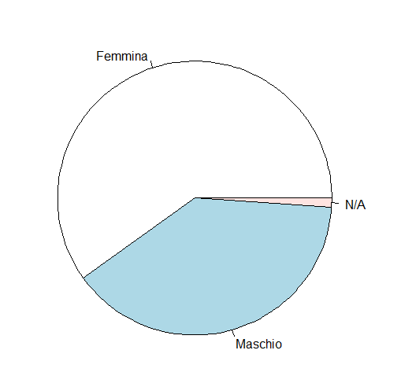
Unit 3: RStudio
Section 6 : Graphs in R (Plot)
PIE CHART WITHOUT PERCENTAGES

Slide 41
Unit 3: RStudio
Section 6 : Graphs in R (Plot)
PIE CHART WITH PERCENTAGES
labels <- c("Femmina", "Maschio", "N/A") #ADD LABELS
n<-lenght(ANAG) #IMPUTATION OF SAMPLE NUMBERS
pct <- round(x/n*100) #CALCULATION OF PERCENTAGES
lbls <- paste(labels, pct) # ADD PERCENTAGES TO LABELS
lbls <- paste(lbls,"%",sep="") # ADDS THE SIMBOL % TO LABELS
pie(x,labels = lbls, col=rainbow(length(lbls)),main= "Grafico a torta del genere dei rispondenti")

Slide 42
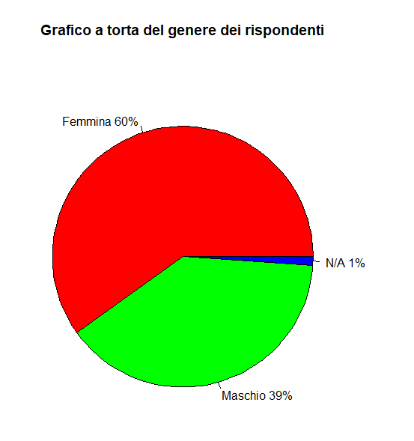
Unit 3: RStudio
Section 6 : Graphs in R (Plot)
PIE CHART WITH PERCENTAGES

Slide 43
Unit 3: RStudio
Section 6 : Graphs in R (Plot)
BAR CHART
Useful for qualitative characters and to highlight the absolute frequencies of each variable.
X<-table(sesso)
barplot(x, main="Genere dei rispondenti", border="blue", ylab="Frequenze Assolute")

Slide 44
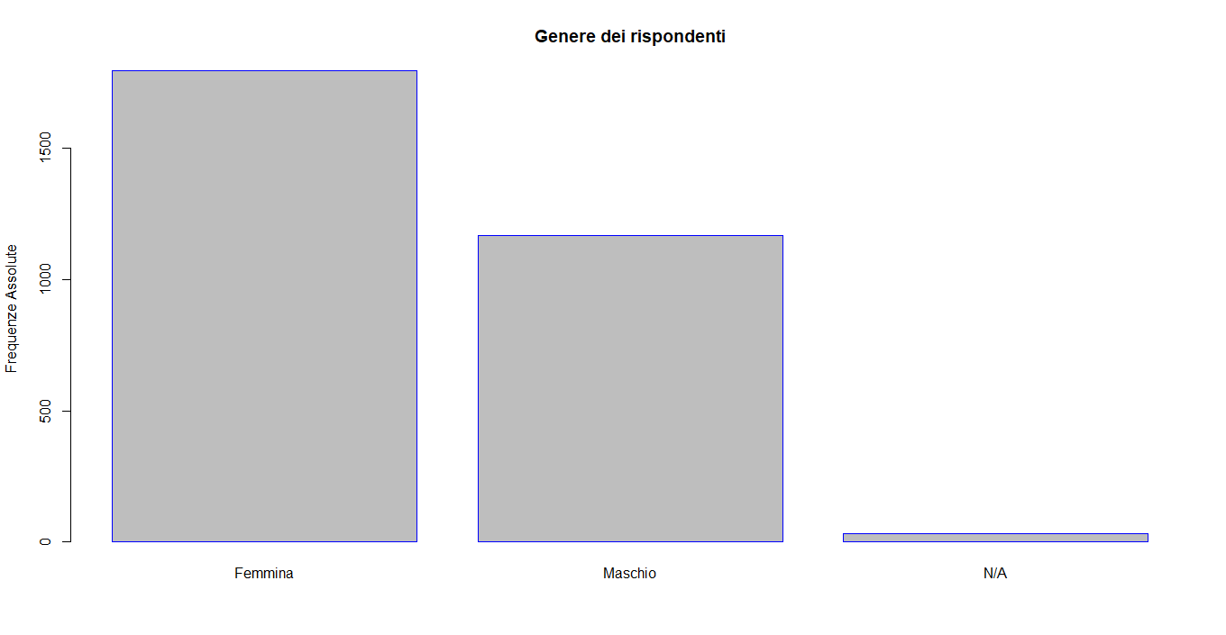
Unit 3: RStudio
Section 6 : Graphs in R (Plot)
BAR CHART

Slide 45
Unit 3: RStudio
Section 6 : Grafici in R (Plot)
BAR CHART: Calculate relative frequencies
prop.table(table(sesso))

Slide 46
Summing up
It has a huge catalog of packages for importing data, cleaning and manipulating, statistical analysis
Most of the statistical techniques have been implemented in the R environment.
RStudio working environment consists of 4 windows: Code, Console, Objects, Packages
The most commonly used and most accessible interface is RStudio
Internet is full of resources, including free ones, that allow you to learn how to use R
The language was specifically created and developed for data analysis.

Slide 47
Self-assessment test
How many windows does the working environment of R studio consist of?
4
3
None
2. R script allows you to:
Create a project report
Create a file where you can insert all the codes
Download a package
3. To create a pie chart in R you use the command?
scatterplot
barplot
pie

Slide 48
Self-assessment test: Answers
How many windows does the working environment of R studio consist of?
4
3
None
2. R script allows you to:
Create a project report
Create a file where you can insert all the codes
Download a package
3. Do you use the command to create a pie chart in R?
scatterplot
barplot
pie

Slide 49
Thank you!

