Slide 1
Correspondence Analysis
By [UNISALENTO]

Slide 2
Index
1
2
3
Unit 1: Introduction
Correspondence Analysis, AC
AC goal
AC assumption
Unit 2: Correspondence Analysis
Contingency tables
Distances between profiles
Unit 3: Case study on RStudio
Import the Dataset
Chi-square test
Correspondence Analysis on R

Slide 3
Unit 1: Introduction
Section 1: Correspondence Analysis, CA
Correspondence analysis is a statistical method for the analysis of multidimensional data, it is a multivariate technique that analyzes patterns of association between qualitative variables.

Slide 4
Unit 1: Introduction
Section 1: Correspondence Analysis, CA
Qualitative variables are variables that are not represented by numbers, but by modalities, for example: gender, level of education, marital status, etc.

Slide 5
Unit 1: Introduction
Section 1: Correspondence Analysis, CA
Since qualitative variables are used in the AC, the object of the analysis are the contingency matrices, whose elements indicate the number of times (the counts) that the characteristics of two different quantities have been detected together.

Slide 6
Unit 1: Introduction
Section 2: Goal of Correspondence Analysis
The main goal of AC is to analyze the relationships between a set of qualitative variables observed on a collective of statistical units. This is done through the identification of an "optimal" space, i.e. a small dimension that represents the synthesis of the structural information contained in the original data.

Slide 7
Unit 1: Introduction
Section 2: Goal of Correspondence Analysis
In essence, they will build a series of latent variables (or factors), a combination of the original variables, which express some concepts not directly observable in reality, but the result of the measurement of a set of variables.

Slide 8
Unit 1: Introduction
Section 3: The assumption in Correspondence Analysis
In Correspondence Analysis, the variables used do not have to be independent, so the modes of one variable must influence the modes of the other.

Slide 9
Unit 1: Introduction
Section 3: The assumption in Correspondence Analysis
Before carrying out a correspondence analysis it is necessary to establish the degree of interdependence between the characters considered because, if they are independent, it may not make sense to search for the correspondences between them. For this purpose, it is necessary to apply the Chi-square test, which assesses any interdependence relationships between the qualitative variables

Slide 10
Unit 1: Introduction
Section 3: The assumption in Correspondence Analysis
The test starts of the null hypothesis that considers the two independent variables. The alternative hypothesis will be that the two variables have a certain degree of interdependence. If the test results return a p-value < 0.05, the null hypothesis can be rejected and consequently the two variables will be considered interdependent, and you can continue with the analysis.

Slide 11
Unit 2: Correspondence Analysis
Section 1: Contingency Tables
The contingency tables contain the joint frequencies of the variable modes. Given two qualitative variables X and Y, the relevant contingency table will contain how many times a given mode of variable X occurs with a given mode of variable Y.

Slide 12
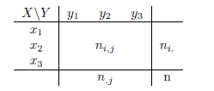
Unit 2: Correspondence Analysis
Section 1: Contingency Tables
X, Y are the qualitative variables.
$x_{1}, x_{2} , x_{3}$: are the modes of the variable X
$y_{1}, y_{2} , y_{3}$: are the modes of the variable Y
$n_{i,j}:$ are the absolute joint frequencies, i.e the frequencies of the pairs, example $n_{1,1}: {X=x}_{1};Y= y_{1}$
$n_{i·}$: are the marginals of row ; $n_{·j}$: are marginals of column. There are the sum for the fixed row (or column) of the joint frequencies on the modes of Y (for columns on the modes of X).
n = is the sample number, which can be obtained in various ways: by adding the marginals of row or column; or by adding the absolute joint frequencies.

Slide 13
Unit 2: Correspondence Analysis
Section 1: Contingency Tables
The Correspondence Analysis allows to represent the phenomenon both in the space of the rows and in the space of the columns. To do this, the row and column profile matrices must be constructed: - dividing the absolute frequencies by the corresponding marginal rows (or column); - dividing the relative frequencies (i.e. the absolute frequencies divided by the total number of the sample) by the respective row (or column) margins.

Slide 14
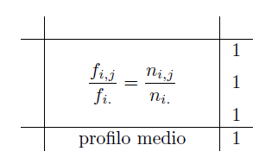
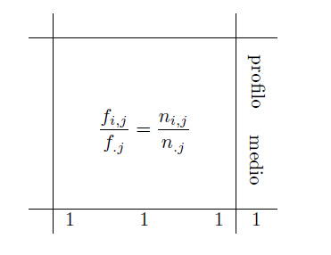
Unit 2: Correspondence Analysis
Section 1: Contingency Tables
Row Profile Matrix
Column Profile Matrix

Slide 15
Unit 2: Correspondence Analysis
Section 2: Distances Between Profiles
Finally, you have to calculate the distances between the profiles to see if the modalities are similar or not, distant or not, i.e. see if the profiles resemble each other or not. There are two types of distances: the Euclidean distance and the Chi-square distance.

Slide 16
Unit 2: Correspondence Analysis
Section 2: Distances Between Profiles
Euclidean distance favours higher distances than lower ones and is calculated by making the difference between the relative frequencies and then squaring them.

Slide 17
Unit 2: Correspondence Analysis
Section 2: Distances Between Profiles
- The distance of the Chi-square favours the lowest distances as it takes into account the number with respect to the rows. It is calculated by weighting the difference in frequencies relative to the frame by the inverse of the marginal of row (or column).

Slide 18
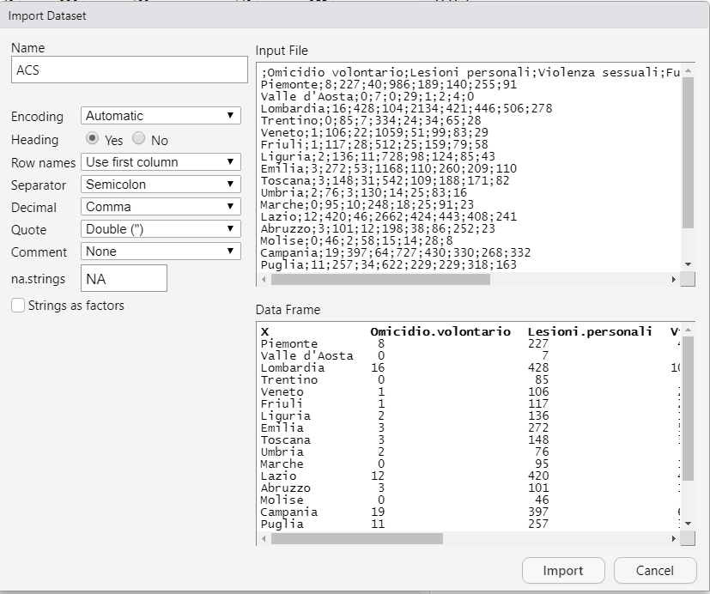
Unit 3: A Case Study
Section 1: Import the Dataset
From Text File, then select the directory and file

Slide 19
Unit 3: A Case Study
The Chi-quadro test is necessary to verify that the variables, are not independent (in this case the Italian regions and the crimes committed in Italy) The null hypothesis of the test will be: ''Variables are Independent''
Section 2: Chi-square Test
One of the criteria for rejecting or not rejecting the null hypothesis is to observe the p-value. Given an alpha= 5%, the p-value: 2.2e-16. Since the p-value is less than 5%, i.e. 0.05, the null hypothesis is rejected, so the two variables are considered with a certain degree of dependence.

Slide 20
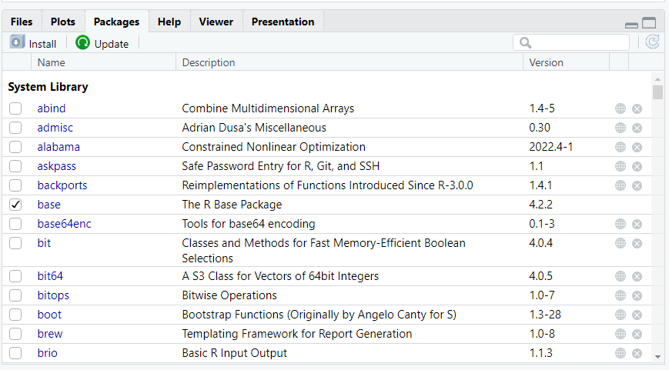
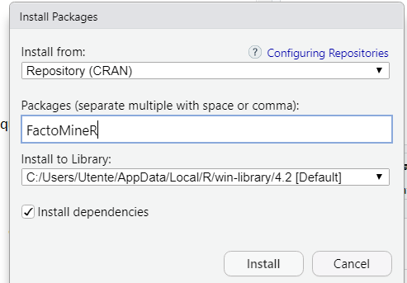
Unit 3: A Case Study
Section 3: Correspondence Analysis on R
For the AC, R provides a package called FactoMineR. First you need to install the FactoMineR package.

Slide 21
Unit 3: A Case Study
Section 3: Correspondence Analysis on R
We call the package downloaded with the command library
For convenience we call our matrix X
We perform correspondence analysis with the CA command
The summary command displays the results of the analysis
Given the objective of the AC, observing the inertia explained, we can see how much size the phenomenon is reduced to. We see that the first dimension alone explains about 60% of the overall variability of the data.

Slide 22
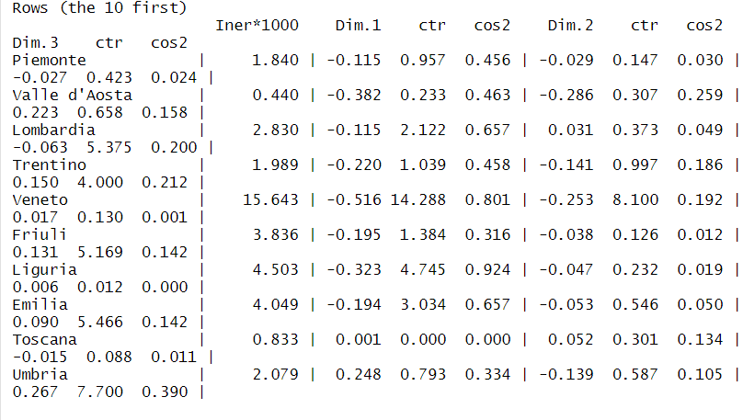
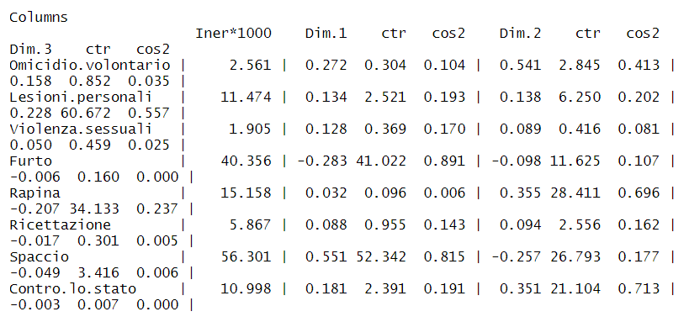
Unit 3: A Case Study
Section 3: Correspondence Analysis on R
CTR are the absolute contributions and highlight how much a mode influences the creation of the factorial axis.
$\cos^{2}$are the relative contributions and indicate the quality of the representation.

Slide 23
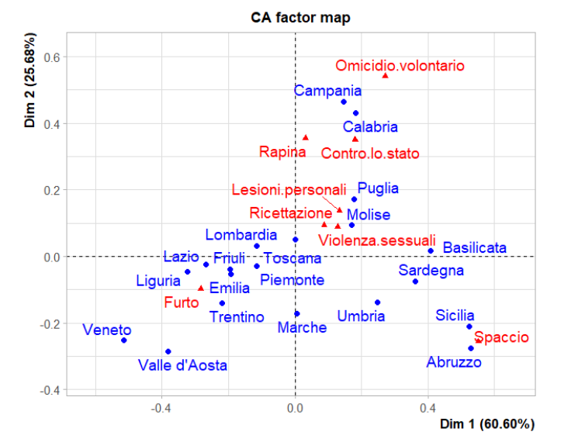
Unit 3: A Case Study
Section 3: Correspondence Analysis on R
Joint two-dimensional graph individual-variables graphically represents how the modes of the two variables are arranged along the axes created by the newly extracted dimensions.

Slide 24
Summarizing
Goal of Correspondence Analysis
Contingency tables
Distance between profiles
Type of variables you can use
Row profile matrix and column profile matrix
Chi-square test

Slide 25
Assessment test
What is the goal of Correspondence Analysis?
A) Maximize explained variability
B) Maximize explained inertia
C) Minimize explained inertia
2. Correspondence analysis works on:
A Contingency tables
B) Correlation tables
C) Simple deployments
3. Why is the chi-square test carried out?
A) To check if variables are qualitative
B) To check if variables are quantitative
C) To analyze the existence of interdependence between the two variables

Slide 26
Assessment test: Answers
What is the goal of Correspondence Analysis?
A) Maximize explained variability
B) Maximize explained inertia
C) Minimize explained inertia
2. Correspondence analysis works on:
A) Contingency tables
B) Correlation tables
C) Simple deployments
3. Why is the chi-square test carried out?
A) To check if variables are qualitative
B) To check if variables are quantitative
C) To analyze the existence of interdependence between the two variables

Slide 27
Thank you!

