Slide 1
Training module title
By [UNISALENTO]

Slide 2
Index
1
2
3
Unità 1: Introduction
Cluster Analysis
Goal
Type of Variables
Unità 2: Cluster Analysis
Dissimilarity Matri
Cluster Creation
Fusion Distance and Dendogram
Unità 3: Case Study
Distance Matrix Choice of link: fusion distance and dendogram

Slide 3
Unit 1: Introduction
Section 1: Cluster Analysis
Cluster analysis is a type of multivariate analysis technique that can be applied in many fields: from computer science, medicine and biology, from archaeology to marketing, whenever it is necessary to classify a large amount of information into distinguishable groups.

Slide 4
Unit 1: Introduction
Section 2: Goal
Cluster analysis is used to group statistical units (records) that have common characteristics and assign them to categories not defined a priori. The groups (clusters) formed must be as homogeneous as possible inside (or even similar, intra-cluster) and heterogeneous outside (or even dissimilar, inter-cluster).

Slide 5
Unit 1: Introduction
Sezione 3: Tipo di Variabili
In Cluster Analysis you can use:
quantitative variables, therefore numeric;
qualitative variables, which present modalities (e.g. gender, level of education, marital status, etc.)

Slide 6
Unit 2: Cluster Analysis
Section 1: Dissimilarity Matrix (or Distance Matrix)
The distance matrix D is useful to know how many statistical units are different from each other, it is decisive for the choice of variables to be considered. The distance matrix, of dimensions $n×n$, is a symmetric matrix that has on the greater diagonal all 0, this is because the distance between a point and itself is zero.

Slide 7
Unit 2: Cluster Analysis
Section 1: Dissimilarity Matrix (or Distance Matrix)
Before creating the distance matrix, the starting matrix must be standardized, so each variable will have the same weight as the others.

Slide 8
Unit 2: Cluster Analysis
Section 1: Dissimilarity Matrix (or Distance Matrix)
To obtain the distance matrix D it is necessary to calculate the distances between the points. Depending on the type of variable, quantitative or qualitative, with which you are working, these distances can be calculated in different ways.

Slide 9
Unit 2: Cluster Analysis
Section 1: Dissimilarity Matrix (or Distance Matrix)
Quantitative variables:
Euclidean distance, sensitive to outliers.
Manhattan distance, very robust.
Qualitative variables:
The frequencies are taken into account, the similarity matrix is created and the concordances and discrepancies between the choices are calculated.
Two types of similarity indices:
Zubin, for symmetric binary variables. Jaccard, for asymmetric binary variables.

Slide 10
Unit 2: Cluster Analysis
Section 2: Creating Clusters
Thanks to the link rule we can choose the type of link that we will use to form clusters, among the following:
Simple linkage
Complete linkage
Average linkage

Slide 11
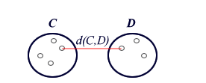
Unit 2: Cluster Analysis
Section 2: Creating Clusters
Simple linkage:
The groups are put together according to the minimum distance between the observations, this link favors the homogeneity of the elements of each group to the detriment of differentiation.

Slide 12
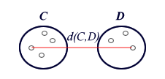
Unità 2: Analisi in Cluster
Sezione 2: Creazione dei Cluster
Complete linkage:
The groups are put together according to the minimum maximum distance between the points, so first the greatest distances between the groups are calculated and then those that have the least distance are chosen. This type of link highlights differences between groups rather than internal homogeneity.

Slide 13
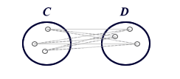
Unità 2: Analisi in Cluster
Sezione 2: Creazione dei Cluster
Average linkage:
The groups are put together according to the minimum average distance, i.e. first calculate the average distance between all the observations and then between them we take the minimum distance. This type of link is less sensitive to extreme values, so it will be more robust.

Slide 14
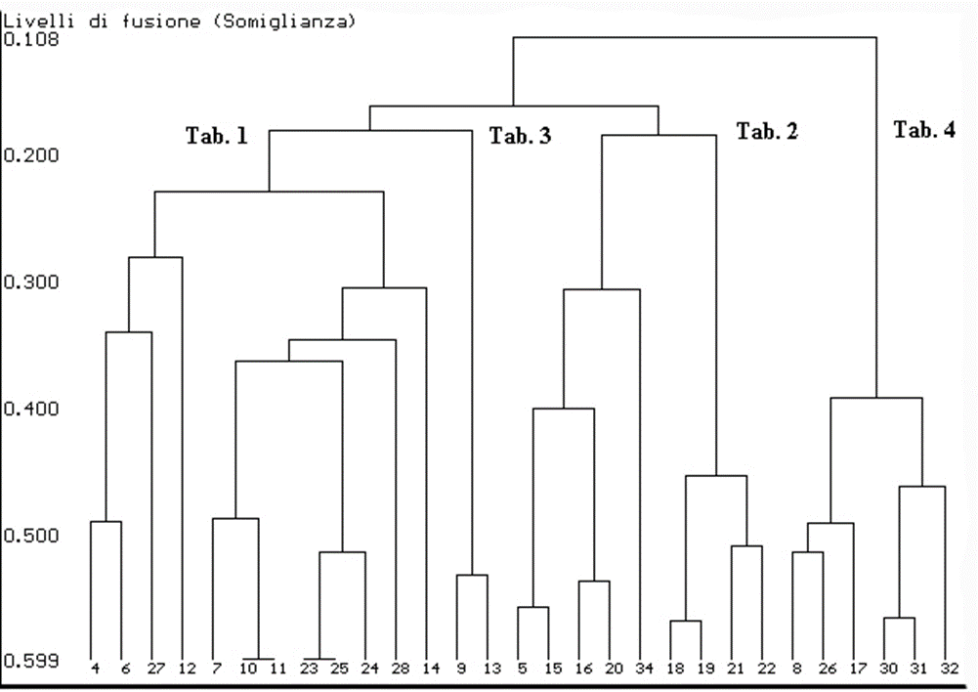
Unit 2: Cluster Analysis
Section 3: Fusion Distance and Dendogram
After choosing the most appropriate link for your analysis and the creation of groups, you can create the graphic representation: the Dendogram. It is represented according to increasing ordinates the level of aggregation of the clusters. On the x-axis there are points, on the y-axis there are distances.

Slide 15
Unit 2: Cluster Analysis
Section 3: Fusion Distance and Dendogram
The distance between clusters tends to increase and for this reason we choose a stop rule that allows us to choose the number of groups we want to get.
To do this we use the tree cutting technique:
Looking at the longest branches;
Through the criterion of parsimony (usually 4-5 homogeneous clusters inside and heterogeneous outside); With the fusion distances Scree-plot (when the graph flattens, or if in the transition from g to g+1 groups there is a strong increase);
Taking care that there are no outliers (clusters composed of a single point).

Slide 16
Unit 3: Case Study on R
Section 1: Creating the Distance Matrix
After importing the dataset into R, we start with the analysis in Cluster:
The starting matrix is standardized
Distances are calculated:
Euclidean
Manhattan
The round command allows us to round to the significant figure we prefer.

Slide 17
Unit 3: Case Study on R
Section 2: Choosing the Type of Link
Simple linkage:
The hclust command creates clusters, specifying the distance you want to use and the.
‘’single’’: for the simple linkage.
‘’compl’’: for the complete linkage.
‘’average’’: for the average linkage.
The plot function allows us to graphically display the Dendogram.

Slide 18
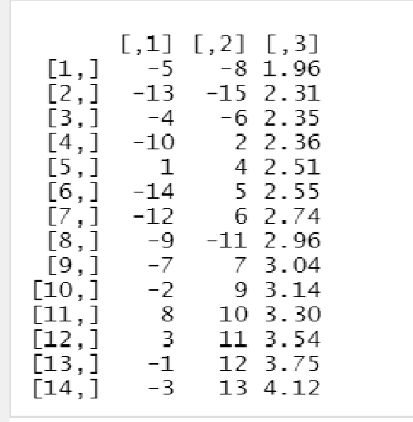
Unit 3: Case Study on R
Section 2: Choosing the Type of Link
Groups are created based on their fusion distance: The first group, for example, consists of elements 5 and 8 of the dataset, which have a blending distance = 1.96. The minus sign indicates that it is a single item, otherwise the indicated element will be a previously formed group.

Slide 19
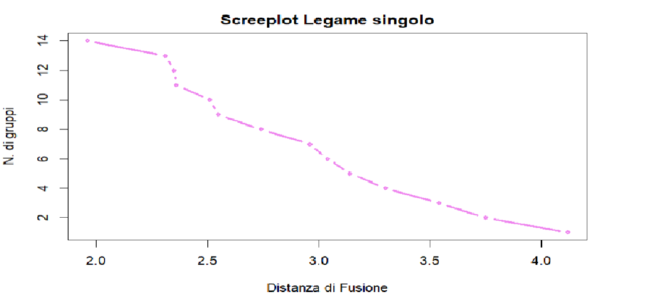
Unit 3: Case Study on R
Section 2: Choosing the Type of Link
With the plot function the scree-plot of the fusion distances is realized that will allow us to cut tree.
Through the Scree-Plot we observe that the fusion distance with which we can make the cut tree is 2.

Slide 20
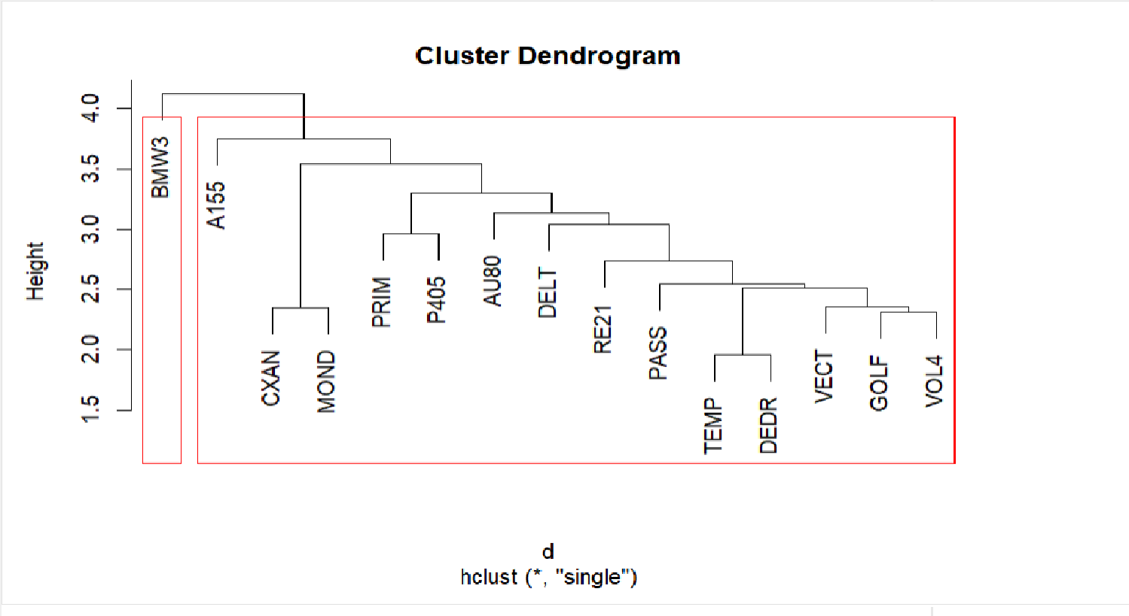
Unit 3: Case Study on R
Section 2: Choosing the Type of Link The result obtained with the Simple linkage:

Slide 21
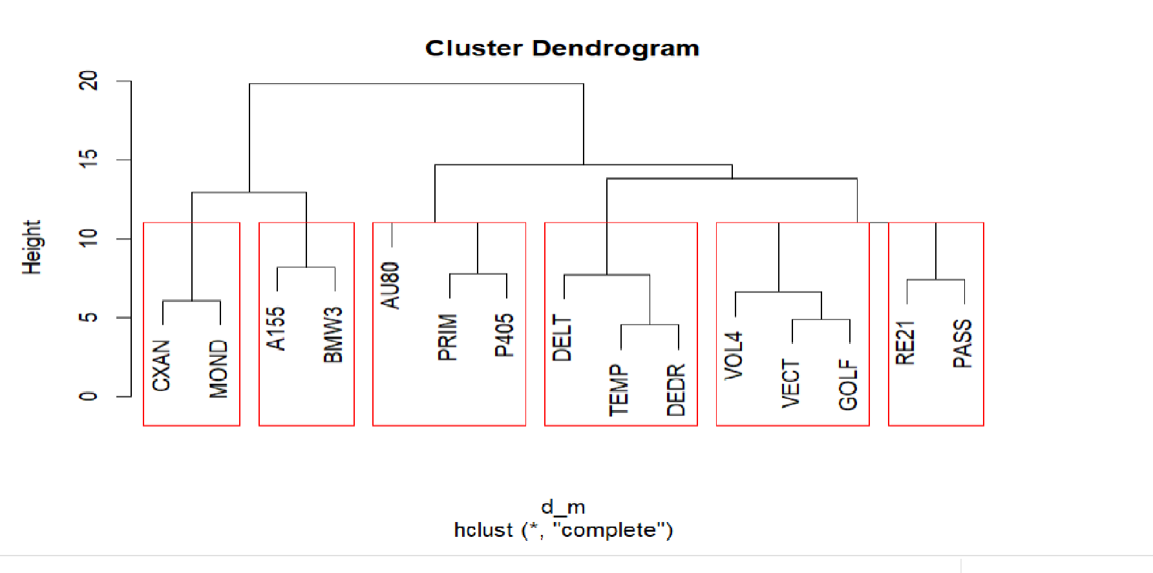
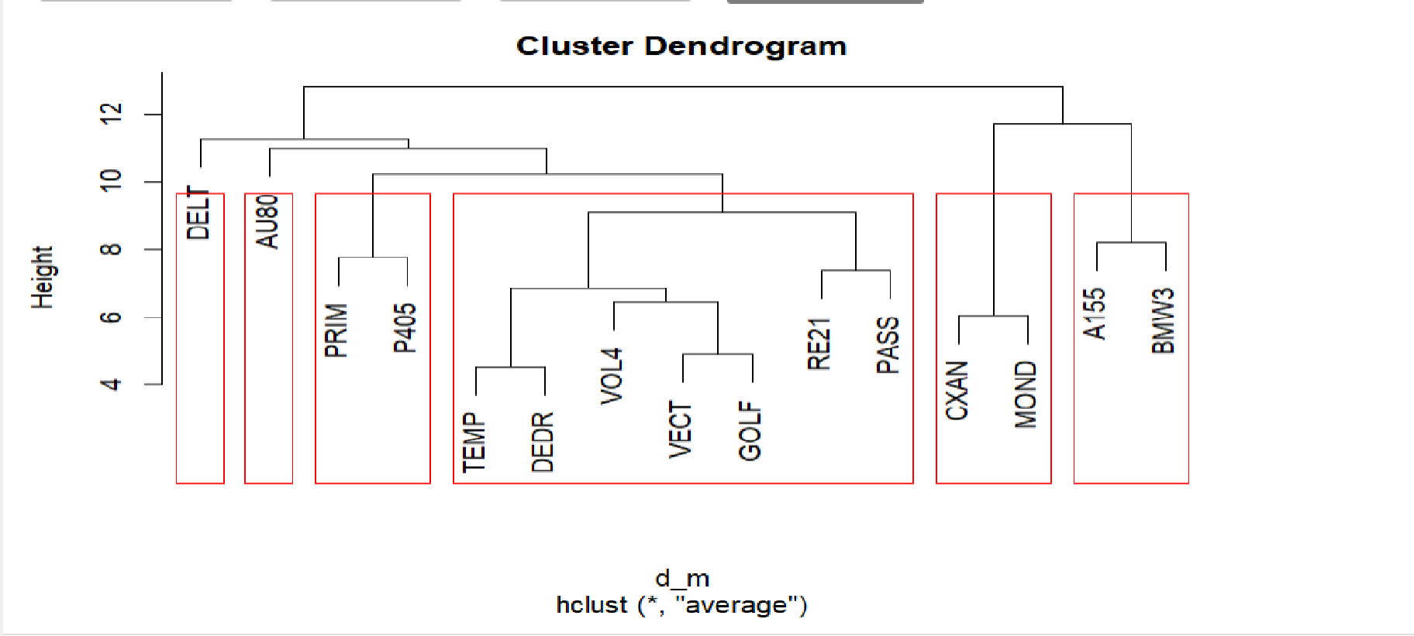
Unit 3: Case Study on R
Section 2: Choosing the Type of Link
The same procedure is carried out for the complete linkage and the average linkage. You will compare the results and choose the most representative link for the analysis you are conducting.
Comparing the three links, the most suitable is the complete likage as it divides the clusters better, avoiding that there is too much internal homogeneity at the expense of external heterogeneity. It also prevents the formation of outliers, i.e. clusters composed of a single point.

Slide 22
Summary
Goal of the Cluster Analysis
Distance matrix (or Dissimilarity)
Fusion Distance
Type of variables to use
Type of link to be used
Dendogram

Slide 23
Assessment test
What is the goal of Cluster analysis?
A) Putting together statistical units according to common characteristics
B) Create linear combinations of starting variables
C) Reduce the number of variables to explain a phenomenon
2. What kind of variables can be used in Cluster analysis?
A) Only qualitative
B) Only quantitative
C) Qualitative and quantitative
3. The distance matrix:
A) It has on the greater diagonal all 0
B) It has on the largest diagonal all 1
C) It has on the diagonal greater negative values

Slide 24
Assessment test
What is the goal of Cluster analysis?
A) Putting together statistical units according to common characteristics
B) Create linear combinations of starting variables
C) Reduce the number of variables to explain a phenomenon
2. What kind of variables can be used in Cluster analysis?
A) Only qualitative
B) Only quantitative
C) Qualitative and quantitative
3. The distance matrix:
A) It has on the greater diagonal all 0
B) It has on the largest diagonal all 1
C) It has on the diagonal greater negative values

Slide 25
Thank you!

