Slide 1
PRINCIPAL COMPONENT ANALYSIS (PCA)
[UNISALENTO]

Slide 2
Index
1
2
3
INTRODUCTION 1. Objectives 2. Definition
PCA REQUIREMENTS Variable Analysis
HOW TO CONDUCT PCA 1. Sample Adequacy 2. Extraction Main components 3. The criteria
4. Case study

Slide 3
Introduction
Objective
the objective of this module is to introduce and explain the technique of Principal Component Analysis.
At the end of this module you will be able to:
Know the logic of the PCA;
Know the criteria;
Conduct an PCA.

Slide 4
Introduction
Definition
Principal component analysis (PCA) is a statistical technique of multivariate analysis for size reduction. In practice, it is used when within a dataset there are many variables related to each other and you would like to reduce the number by losing the least amount of information possible.
The PCA has the objective of maximizing variance, calculating the weight to be attributed to each starting variable in order to concentrate them in one or more new variables (called main components) that will be linear combination of the starting variables

Slide 5
Introduction
PCA in real Life
Social sciences is frequently faced with research in which there is an overabundance of measurements (indicators) in order to better understand the phenomenon being studied.
An example in which to use PCA may be the evaluations expressed by students with reference to a certain course with several variables. Often a large number of variables are used to measure the satisfaction of a course, such as the evaluation of the text books, the material used, the degree of comfort of the classrooms, the timetables, the number of hours devoted to reception or tutoring, and so on. The PCA will reduce the dimensions and make the analysis more simplified

Slide 6
PCA requirements
Variable Analysis
To conduct the principal component analysis, it is important to analyse the variables to be used in order to be clear about some of their characteristics. Specifically, the variables must have the following requirements

Slide 7
PCA requirements
Variables must be Quantitative
PCA is valid only when the variables are numeric.
If the characters have different units of measurement, you must standardize the variables before proceeding.
However, in some cases it is also used for variables on the "Likert scale" and for "binary variables". Although numerically the results are very similar to each other, in these cases it would be preferable to use alternative methods.

Slide 8
PCA requirements
- There must be a linear correlation between variables
the first step when performing a PCA is to calculate the variance/covariance matrix or the Pearson correlation matrix
PCA, in fact, is a technique that can be used when the assumptions of Pearson's linear correlation index are satisfied

Slide 9
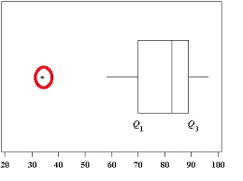
PCA requirements
- No outliers
As with all analyses based on variance, individual outliers can influence the results especially if they are very extreme and if the sample size is low..
To this end, it is useful to create boxplots or scatterplot graphs, from which it is possible to deduce linear relationships between pairs of variables.

Slide 10
PCA requirements
Sufficiently large sample size
There is no unique threshold value, but in general it is recommended to have at least 5-10 statistical units for each variable you want to include in the PCA.
For example, if you want to try to summarize 10 variables with new components, it would be advisable to have a sample composed of at least 150 observations.

Slide 11
How to conduct PCA
- Sample adequacy
To verify the adequacy of the sample, some tests can be carried out such as:
The Kaiser-Meyer-Olkin test, (KMO), which determines whether the variables considered are indeed consistent for the use of a principal component analysis. This index can take values between 0 and 1. For a principal component analysis to make sense, it must have a value of at least 0.5.
Bartlett's Test of Sphericit: is a hypothesis test with the null hypothesis that the correlation matrix coincides with the identity matrix. If this were the case, it would make no sense to perform a PCA as it means that the variables are not linearly correlated with each other at all.

Slide 12
How to conduct PCA
- Extraction of Principal Components
To better understand this concept, imagine that your dataset is a city unknown to you!
Each Principal component is a street of this city. If you wanted to know this city, how many streets would you visit? You would probably start from the central street (the first main component) and then you would enter other streets.
But how many?

Slide 13
How to conduct PCA
Extraction of Principal Components
To be able to say you know a city well enough, obviously the number of streets to visit depends on the dimensions of the city and how similar or different the streets are.
Likewise, the number of components to be extracted depends on how many variables you have chosen to include within the principal component analysis and how similar these are to each other.
In fact, the better correlated the variables are, the smaller the number of principal components needed to obtain good knowledge of the source variables. On the contrary, the less correlated the variables are, the greater the number of principal components to be extracted in order to have an accurate knowledge of the dataset.

Slide 14
How to conduct PCA: The Criteria
- Eigenvalues greater than 1
According to this rule, we choose those components with an eigenvalue greater than 1.
The eigenvalue is a number that returns the variance explained by the component: since initially the variance explained by each individual variable is equal to 1, it would not make sense to take a component (which is a combination of variables) with a variance of less than 1.
ʎ>1

Slide 15
How to conduct PCA: The Criteria
- Proportion of the Overall Explained Variance
According to this criteria, we hold on to principal components that explain at least 70% of the variance cumulatively.
Furthermore, each individual component to be extracted should provide a significant increase to the overall variance (e.g. at least a 5% or 10% increase in explained variability).

Slide 16
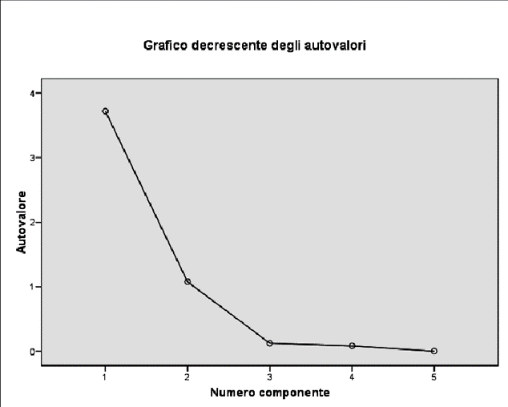
How to conduct PCA: The Criteria
- Scree Plot
This method is based on a graph in which the vertical axis contains the values of the eigenvalues and the horizontal axis all the possible components to be extracted (which will therefore be equal in number to the starting variables). Connecting the points will obtain a broken line that will have a concave shape in some parts and a convex shape in others

Slide 17
How to conduct PCA: The Criteria
- Scree Plot
As you can see from the graph on the x-axis are the components, while on the y-axis are the eigenvalues.
When the curve of this graph makes an 'elbow', we can draw a line, and only take into account the factors above.
From the graph you can see here, for example, you can see that the number of points above the elbow is 2.

Slide 18
How to conduct PCA: The Criteria
- Name them
The final part of the PCA consists of naming the individual principal components found.

Slide 19
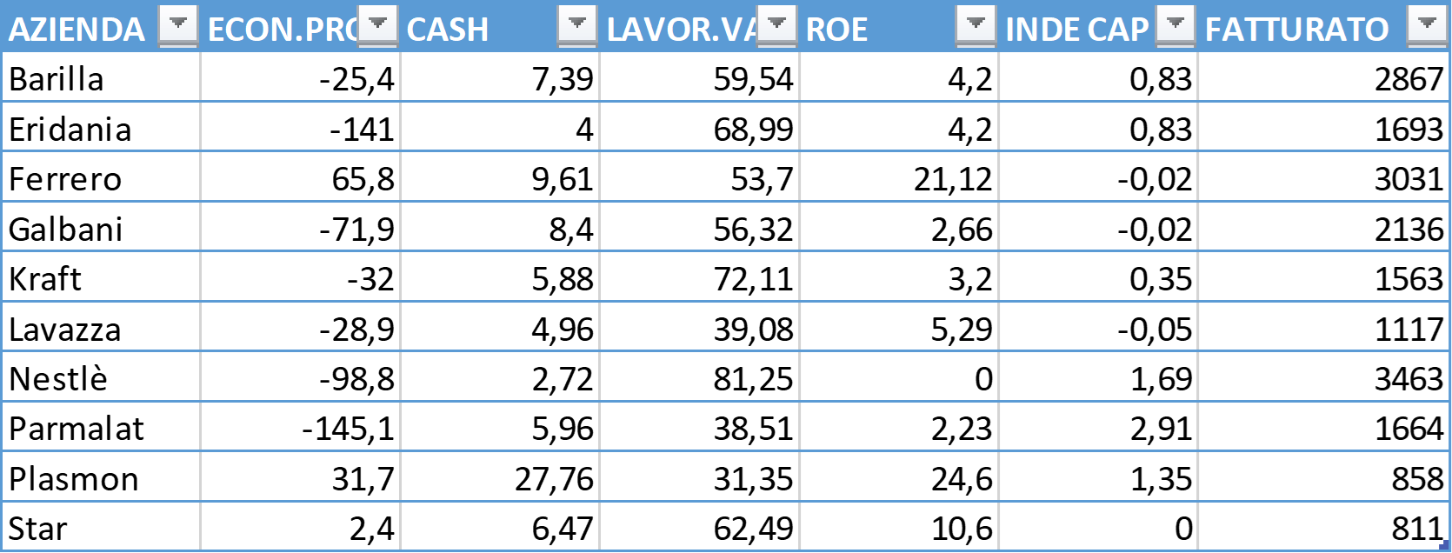
How to conduct PCA: A case study
Suppose we have the following company performance survey on 10 companies
ECON.PRO -> economic profit,
differential between return on
invested capital and its cost
CASH -> cash flow on turnover in %
LAVOR.VA -> labour cost
on added value, in %
ROE -> return on equity, profit
net profit on equity, in %
INDE.CAP -> debt
on equity
FATTURATO: TURNOVER

Slide 20
How to conduct PCA: A case study
Since the data are expressed in very different units, let us turn to the data matrix standardised
AZIENDA | ECON.PRO | CASH | LAVOR.VA | ROE | INDE CAP | FATTURATO
Barilla | -25,4 | 7,39 | 59,54 | 4,2 | 0,83 | 2867
Eridania | -141 | 4 | 68,99 | 4,2 | 0,83 | 1693
Ferrero | 65,8 | 9,61 | 53,7 | 21,12 | -0,02 | 3031
Galbani | -71,9 | 8,4 | 56,32 | 2,66 | -0,02 | 2136
Kraft | -32 | 5,88 | 72,11 | 3,2 | 0,35 | 1563
Lavazza | -28,9 | 4,96 | 39,08 | 5,29 | -0,05 | 1117
Nestlè | -98,8 | 2,72 | 81,25 | 0 | 1,69 | 3463
Parmalat | -145,1 | 5,96 | 38,51 | 2,23 | 2,91 | 1664
Plasmon | 31,7 | 27,76 | 31,35 | 24,6 | 1,35 | 858
Star | 2,4 | 6,47 | 62,49 | 10,6 | 0 | 811

Slide 21
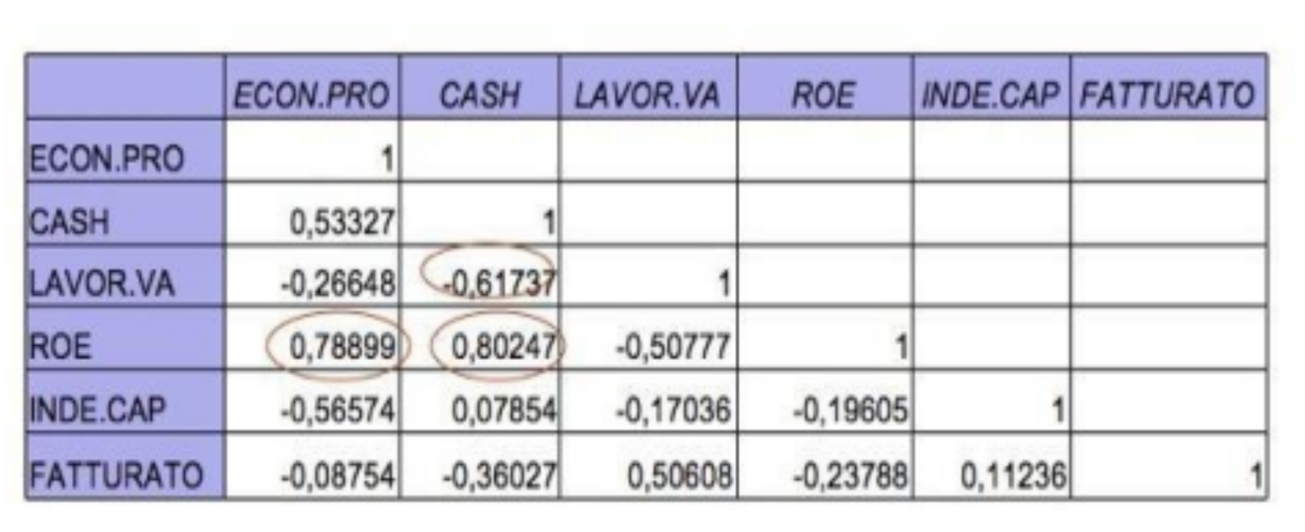
How to conduct PCA: A case study
As already mentioned, the observation of the correlation matrix is an important step: if all variables were uncorrelated, there would be no reason to proceed with the PCA, as you would have as many components as observed variables. If, on the other hand, some are highly correlated, we should consider only one. The table shows that ROE is positively correlated with Cash Flow and the variable economic profit, however we consider them in the analysis

Slide 22
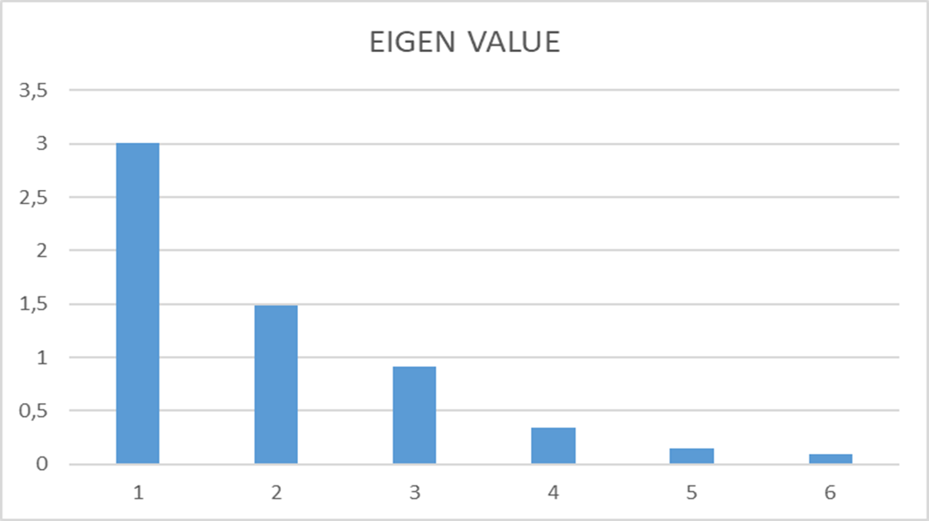
How to conduct PCA: A case study
We must calculate eigenvalues, eigenvectors, we analyse the percentage of variance explained by the eigenvalues using the screeplot.
Eigenvalues greater than 1 in this case explain 74.9% of the original variance
It is possible to extract 2 Components as the first 2 dimensions reach 75% cumulative variance

Slide 23
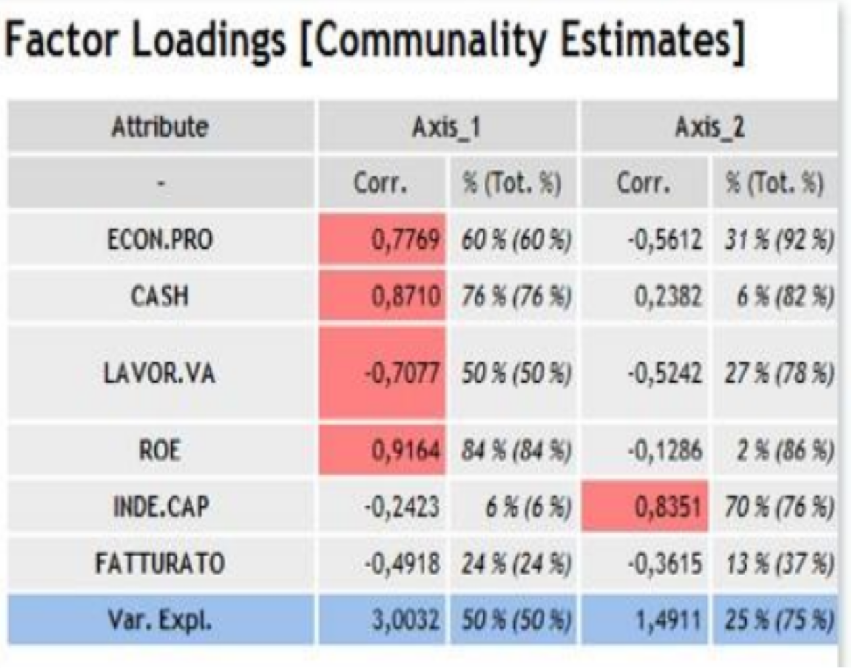
How to conduct PCA: A case study
To understand the role played by each variable in the construction of the factors, and thus to have material to reflect on in order to understand the meaning of the axes, we can analyse the communality, which tells us how much each variable is correlated with the axis.
It can be observed that the most correlated variables are those that determine the first axis. This axis is the most important because it is the one that summarises the maximum variability. And the amount of variability explained is influenced by the correlation between the original variables. The variables correlated with the first axis suggest interpreting it as a summary of profitability (C1): on the right is high profitability, on the left low profitability.
The second axis discriminates on indebtedness (C2): at the top are the companies with a high rate of indebtedness, at the bottom those that are less indebted

Slide 24
How to conduct PCA: A case study
As can be seen from the graph on the next slide:
On the Cartesian diagram, the two extracted principal components represent the axes
while the Individuals (in this case the companies) are projected onto the plane.
They lie closer to the factors depending on how much they have contributed to them.

Slide 25
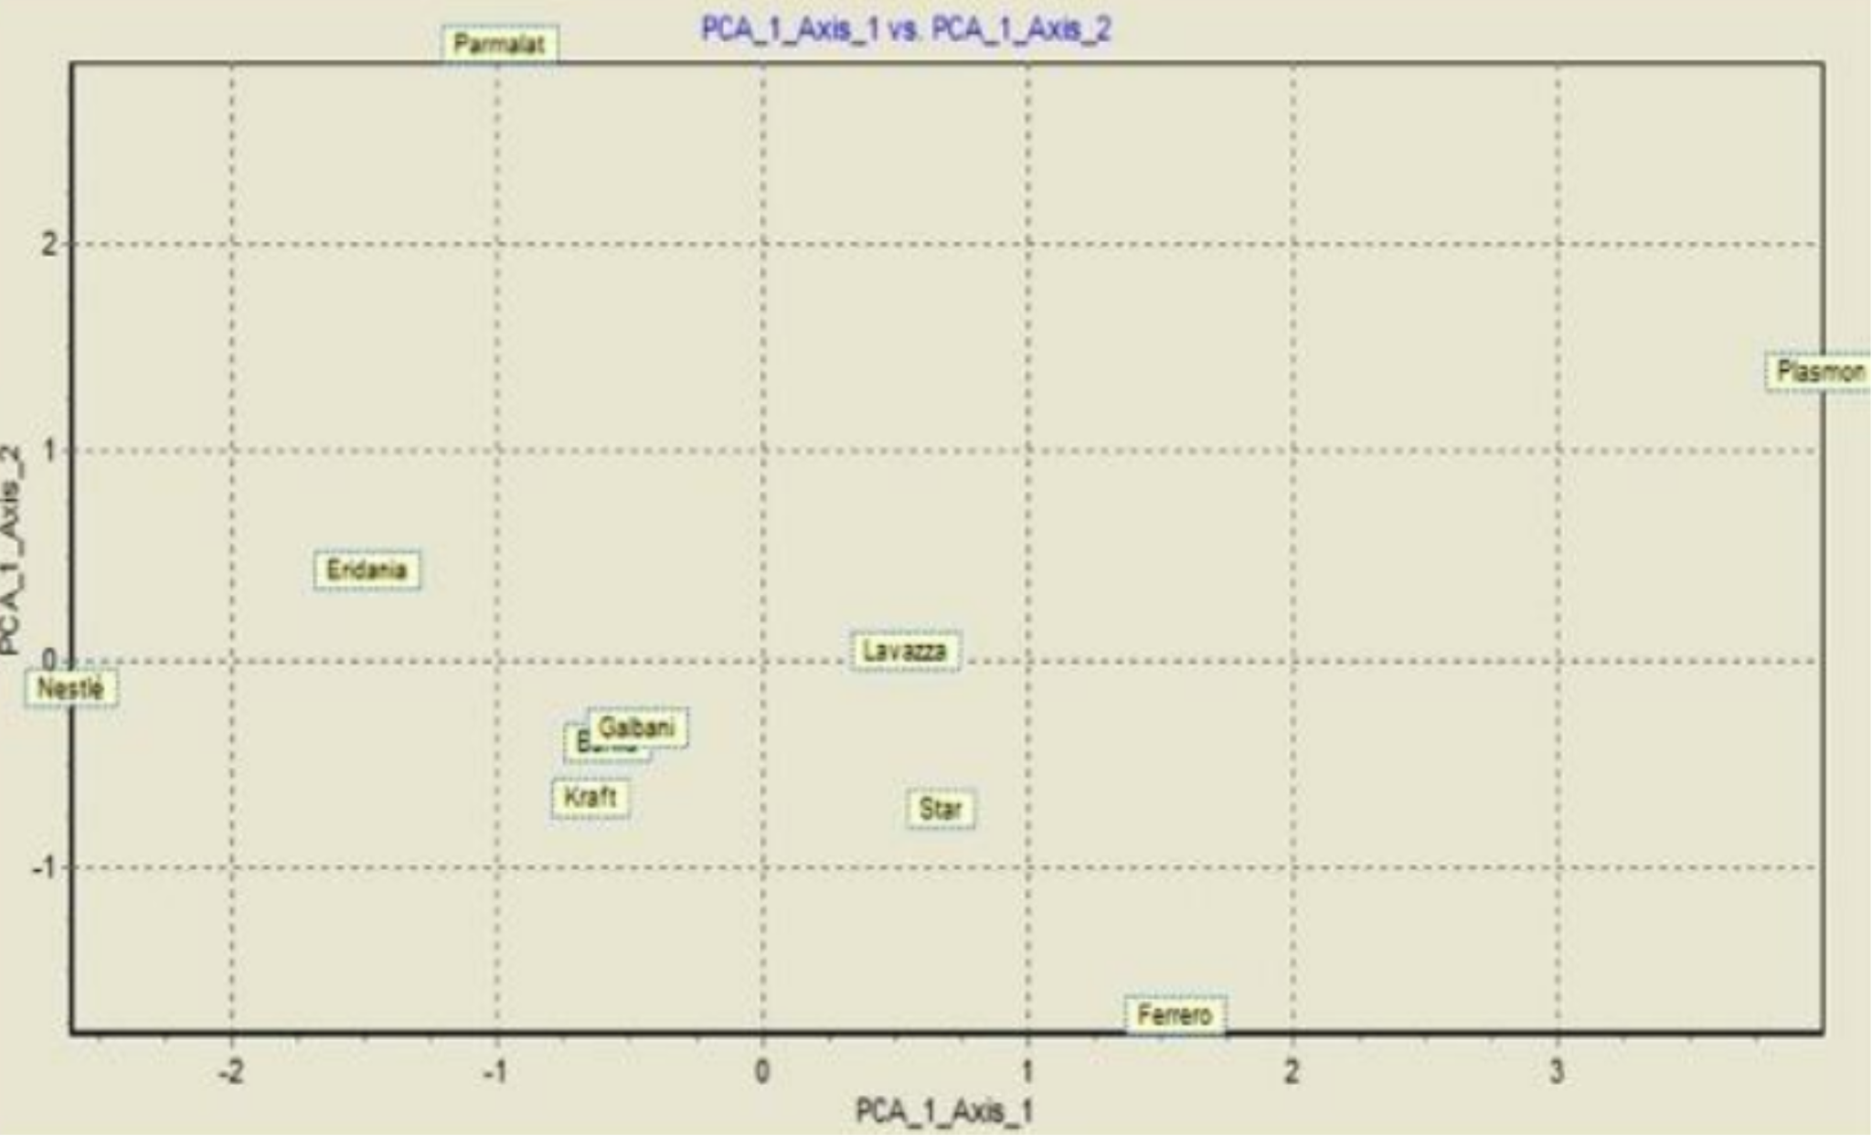

Slide 26
How to conduct PCA: A case study
Interpretation: Some of them are positioned in diametrically opposed areas:
at the bottom right is Ferrero, which is the healthiest company, since it has negative debt, so it meets its financial commitments with its own capital, and a fair profitability
in the top right quadrant, we can find Plasmon, which although heavily in debt has a very high profitability.
in the bottom left quadrant are those companies that operate in saturated markets where they are leaders; moreover, being close to the origin of the axes, they show that they have their financial situation under control, and having negative debt they have capital reserves ready to be used to meet market needs or to undertake penetration actions in highly profitable businesses
Finally, at the top left, we find Parmalat: this one shows the worst situation. It has high indebtedness and negative profitability, so this company must necessarily rethink its business system to avoid the risk of insolvency.

Slide 27
Summing up
Principal component analysis (PCA) is a multivariate statistical technique for dimension reduction.
It is important to check that the data have specific characteristics
The last step is the extraction of the principal components. To do this, we use the following criteria:
- Eigenvalues >1
- Proportion of variance explained at least 70%
- Scree-plot verification
Variables must be Quantitative
After verifying the characteristics, it is necessary to check the adequacy of the sample

Slide 28
Self-assessment test
The goal of the is PCA:
A The aggregation of statistical units according to their distance
B The reduction of the dimensionality of a complex phenomenon
C The description of a dataset
2. The matrix of starting data of an ACP must be
A With qualitative data
B With standardized data
C With quantitative data
3. The components extracted in the Analysis in Principal Components:
A They are linear combinations of the starting variables
B they have the equidistributive property
C They all have eigenvalues > 1

Slide 29
Self-assessment test: answers
The goal of the is PCA:
A The aggregation of statistical units according to their distance
B The reduction of the dimensionality of a complex phenomenon
C The description of a dataset
2. The matrix of starting data of an ACP must be
A With qualitative data
B With standardized data
C With quantitative data
3. The components extracted in the Analysis in Principal Components:
A They are linear combinations of the starting variables
B they have the equidistributive property
C They have all eigenvalues > 1

Slide 30
Thank you!

