Slide 1
Introduction to Machine Learning
By Women in AI Austria

Slide 2
Introduction to Machine Learning
What you can find in this course:
Definitions of AI, machine learning, deep learning, and how they relate to data science
Introduction to some algorithms used in machine learning, including:
Naive bayes [BASIC]
Decision trees [BASIC]
Random forests [INTERMEDIATE]
Neural networks [INTERMEDIATE]
Overview of how the performance of machine learning algorithms can be evaluated

Slide 3
Introduction to Machine Learning
Why should you learn this:
Statistics and Machine Learning provide the main tools for your work as a data scientist. Understanding the various machine learning methods - how they work, what their main advantages are, and how to evaluate their performance on a given task - can help you make better decisions about when to use them and will make you a more versatile data expert.

Slide 4
Index
1
2
3
AI, ML, DL, and data science
Definitions
Types of ML
ML Algorithms
Naive Bayes
Decision Trees
Random Forests
SVM
Neural Networks
Evaluating Performance
Accuracy and Co.
Bootstrapping and Cross-validation
Additional considerations

Slide 5
Unit 1: AI, ML, DL, and Data Science
Section 1: Definitions
AI: Artificial Intelligence
ML: Machine Learning
DL: Deep Learning
DS: Data Science

Slide 6
Unit 1: AI, ML, DL, and Data Science
Section 1: Definitions
AI: Artificial Intelligence
A computer system that can perform tasks normally associated with human intelligence
eg: visual perception, speech recognition, decision-making, translation between languages
General AI vs. Narrow AI:
General AI can do all tasks, narrow AI only a select subset of tasks. There is currently no AI system that can be considered General AI, and whether such a system can exist in the future is a matter of hefty debate.

Slide 7
Unit 1: AI, ML, DL, and Data Science
Section 1: Definitions
AI: Artificial Intelligence
A computer system that can perform tasks normally associated with human intelligence
eg: visual perception, speech recognition, decision-making, translation between languages
If the algorithm ...
... consists of step by step instructions on how to perform the task
then it is symbolic AI
... detects a pattern based on a large amount of data/examples, and uses this pattern to perform the task
then it is machine learning

Slide 8
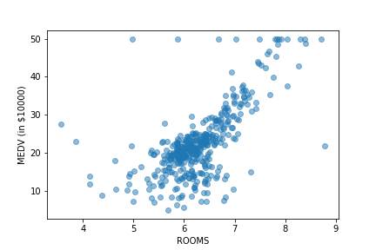
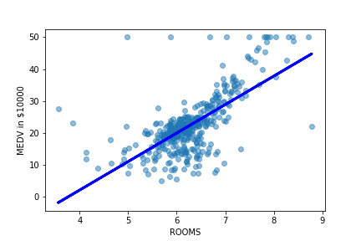
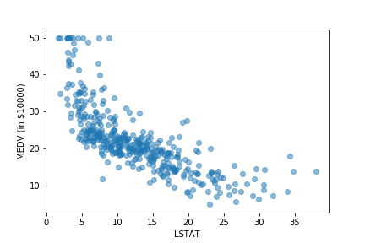
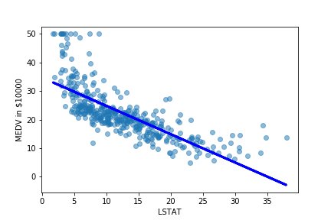
Unit 1: AI, ML, DL, and Data Science
Section 1: Definitions
ML: Machine Learning
Instead of programming every step, a machine is programmed to find patterns, and “learns” based on examples. There is a large area of overlap with Statistics.
Saves thousands of lines of code
Flexible:
if the data changes,
the program adapts.

Slide 9
Unit 1: AI, ML, DL, and Data Science
Section 1: Definitions
ML: Machine Learning
Instead of programming every step, a machine is programmed to find patterns, and “learns” based on examples. There is a large area of overlap with Statistics.
Saves thousands of lines of code
Flexible: if the data changes, the program adapts.
Solves problems we don’t have a step by step solution for: eg. image and sound recognition
Plays games and beats us

Slide 10
Unit 1: AI, ML, DL, and Data Science
Section 1: Definitions
AI: Artificial Intelligence
A computer system that can perform tasks normally requiring human intelligence
ML: Machine Learning
Instead of programming every step, a machine is programmed to find patterns, and “learns” based on examples. There is a large area of overlap with Statistics.
DL: Deep Learning
Currently one of the most popular and successful methods of Machine Learning. Based on neural networks algorithms with many layers (see Unit 2, Section 5).

Slide 11
Unit 1: AI, ML, DL, and Data Science
Section 1: Definitions
AI: Artificial Intelligence
A computer system that can perform tasks normally requiring human intelligence
ML: Machine Learning
Instead of programming every step, a machine is programmed to find patterns, and “learns” based on examples. There is a large area of overlap with Statistics.
DL: Deep Learning
Currently one of the most popular and successful methods of Machine Learning. Based on neural networks algorithms.
DS: Data Science
Uses methods from Machine Learning and Statistics to solve problems and make decisions based on data.

Slide 12
Unit 1 : AI, ML, DL, and Data Science
Section 2: Types of ML
Machine learning algorithms can be sub-divided into three different types.
Supervised learning
Unsupervised learning
Reinforcement learning

Slide 13
Unit 1 : AI, ML, DL, and Data Science
Section 2: Types of ML
Supervised learning
In supervised learning, an algorithm receives «labelled data» as «training» input: labelled data are data sets where each instance (example) consists of independent variables, and the value of the target variable that should be output based on those independent variables. In other words, this is simply learning by example. The goal of the algorithm is to detect a pattern that will enable it to correctly determine the target variable, when the independent variables are known.
Supervised learning is called Classification, when the target variable is a category – for example, determining whether a loan applicant is high-risk or not based on their demographic and previous lending history. It is called Regression when the target variable is quantitative – for example, predicting a nation’s GDP growth based on current economic factors.
Unsupervised learning
Reinforcement learning

Slide 14
Unit 1 : AI, ML, DL, and Data Science
Section 2: Types of ML
Machine learning algorithms can be sub-divided into three different types.
Supervised learning
Unsupervised learning
Unsupervised learning is used to detect patterns in unlabelled data. Clustering (trying to determine similar groups in the data, without knowing apriori which groups to look for), or dimension reduction methods (such as principal components analysis, or LDA) are the most popular types óf unsupervised learning.
Reinforcement learning

Slide 15
Unit 1 : AI, ML, DL, and Data Science
Section 2: Types of ML
Machine learning algorithms can be sub-divided into three different types.
Supervised learning
Unsupervised learning
Reinforcement learning (RL)
Reinforcement learning is used in order to derive an optimal strategy in situations where the algorithmic agent is required to interact with a given environment, and make a sequence of decisions, before the end result is known (i.e. the feedback is not immediate: success vs failure, win vs lose). RL methods are most commonly used in game-playing, or in autonomous driving, and making robots move.

Slide 16
Unit 1 : AI, ML, DL, and Data Science
Section 2: Types of ML
Before proceeding to examine different types of machine learning algorithms in the next unit, a word to the wise:
machine learning is an empirical subject
a priori, there is usually not «one correct method to apply»
you will need to:
collect the requirements for your particular use case,
try out a few different methods (Unit 2),
and then evaluate them according to your chosen metrics (Unit 3) and requirements (for example, perhaps accuracy is not the only important factor, but explainability as well),
to determine which method works «best»

Slide 17
_{Unit 2: ML Algorithms}
Section 1: Naive Bayes
Naïve Bayes is a simple classification algorithm, that is often used as a base-line in natural language processing problems.
Naïve Bayes uses Bayes’ Theorem to transform the problem of determining the probability of an instance belonging to class Y, given its attributes x_{i} , into the problem of evaluating the frequency of attribute x_{i} , given that the instance belongs to class Y.
It can deliver good results when
all the attributes are more or less equally important in determining the target class,
for a fixed target class, the attributes are mutually independent

Slide 18
Unit 2: ML Algorithms
Section 1: Naive Bayes
Naive Bayes comes in different variants:
Gaussian NB: used when the attribute variables are numeric, and it can be assumed that they follow a Gaussian distribution
Simple NB: used when the attribute variables are categorical
Multi-nomial NB: most often used in natural language processing contexts, where the attributes are words in a document

Slide 19
Unit 2: ML Algorithms
Section 2: Decision Trees
Decision trees are both a way of representing information, and an algorithm for detecting patterns in data.
Here we focus on the algorithm for detecting patterns, but we also represent the information gained in the process using a decision tree.
Decision trees consist of nodes and branches
Each node is an attribute, and has branches according to its values. For example, if an attribute is «year in college» and possible attribute values are (Freshman, Sophomore, Junior, Senior), then the node corresponding to «year in college» would have 4 branches.
Decision trees are traversed from the top node down: at each node, a decision as to which branch should be followed next has to be made, based on the value(s) of some particular attribute(s)

Slide 20
Unit 2: ML Algorithms
Section 3: Random forests
Random forests are a special kind of “ensemble learning” – a class of methods that combine models to improve predictive accuracy through diversity.
Random forests consist of multiple randomly chosen decision trees, and
combines their predictions
Random forests vary in the number of trees, and the depth of each tree

Slide 21
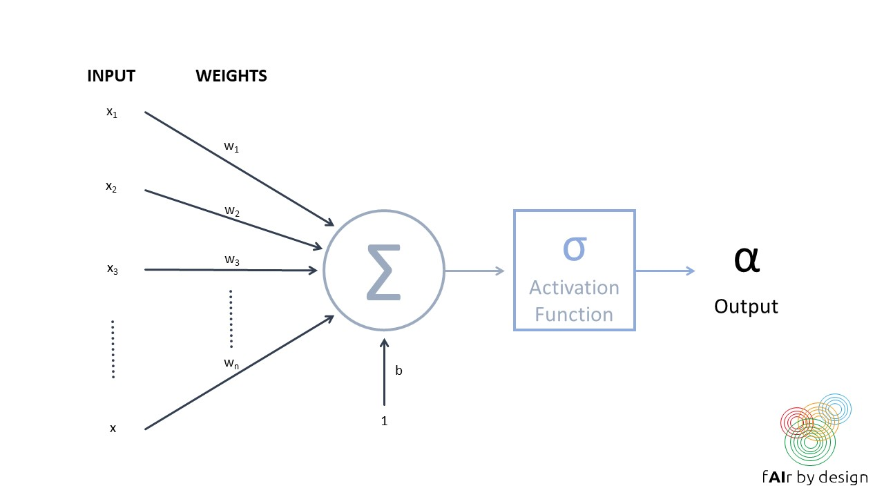
Unit 2: ML Algorithms
Section 5: Neural networks
A neural network consists of a series of interconnected units (so-called "neurons"), like the one depicted in the figure on the right.
Each neuron takes in multiple inputs, assigns each input a weight, then combines and runs them through an activation function, to produce one output.

Slide 22
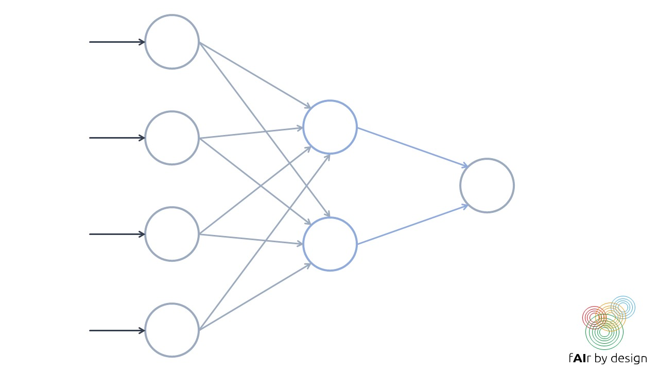
Unit 2: ML Algorithms
Section 5: Neural networks
A neural network is formed by organizing these so-called neurons into layers.
Training a neural network means trying to establish the values for the network weights that minimize prediction error on the training data (as measured by a given loss function).

Slide 23
Unit 3: Evaluating Performance
Section 1: Accuracy and Co.
There are many metrics that can be used for measuring the performance of a trained model. Which one to use depends on the type of model (supervised, unsupervised, or reinforcement learning; classification vs regression), and on the context of use. We will focus on supervised learning.
The most commonly used performance metric for regression models is MSE.
The most commonly used performance metric for classification is accuracy.
However, these are not always the «best» metrics to use.

Slide 24
Unit 3: Evaluating Performance
Section 1: Accuracy and Co.
Binary classifiers are classification systems where there are only two possible target classes:
lets call them POSITIVE and NEGATIVE.
We will examine different performance metrics for these, and why in certain circumstances, they are preferable to accuracy.
Lets start with a commonly used tool to help understand the performance of a binary classifier: the confusion matrix (see next slide)

Slide 25
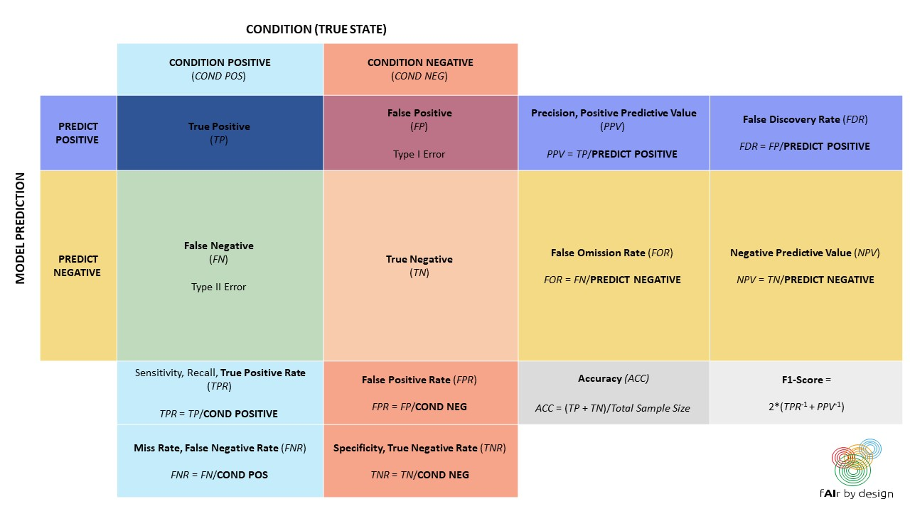

Slide 26
Unit 3: Evaluating Performance
Section 1: Accuracy and Co.
When would you want to use a metric other than accuracy?
When the target classes are severely imbalanced: for example if 95% are POSITIVE, and only 5% are NEGATIVE, then a classifier that simply classified everything as POSITIVE would have an amazing 95% accuracy. But would it be useful?
Is it more important to correctly identify all POSITIVE elements (for example, in a medical diagnosis, you want to make sure that you catch the presence of a disease, so that you can start treatment)? Or is it more important to avoid false POSITIVES?

Slide 27
Unit 3: Evaluating Performance
Section 1: Accuracy and Co.
Lets consider a „real-life“ example: automated hate speech detection on social media.
According to data obtained in Amnesty International Italy‘s „Barometro dell‘Odio“ project (see the data4good slides), hate speech makes up about 1% of online political content. In that case, even for a stellar hate speech detection system with 99% TPR and 1% FPR:
For every 100 comments that it labels as hate speech, we can expect ___ of them to actually be neutral comments.
(Try to figure it out yourself before proceeding to the next slide)

Slide 28
Unit 3: Evaluating Performance
Section 1: Accuracy and Co.
Lets consider a „real-life“ example: automated hate speech detection on social media.
According to data obtained in Amnesty International Italy‘s „Barometro dell‘Odio“ project (see the data4good slides), hate speech makes up about 1% of online political content. In that case, even for a stellar hate speech detection system with 99% TPR and 1% FPR:
For every 100 comments that it labels as hate speech, we can expect 50 of them to actually be neutral comments.

Slide 29
Unit 3: Evaluating Performance
Section 1: Accuracy and Co.
Don‘t take my word for it
The next page has an embedded excel sheet – you can play around with the numbers yourself.

Slide 31
Unit 3: Evaluating Performance
Section 2: Bootstrapping and Cross-validation
Bootstrapping:
Bootstrapping is based on doing a Random Sampling with Replacement (that means, one takes the vase with colored balls, so common in probability texts, that one randomly pulls out a ball, notes the color, and throws the ball back into the vase) on the training data. This means that the same observation can be drawn several times, while other observations may not be drawn at all.
This statistical fact is exploited: samples are drawn from the training data as often as necessary until a new training data set of the same size is obtained. Those observations that were never drawn in this procedure are put into the validation data set. The validation results are used to compare the different algorithms.

Slide 32
Unit 3: Evaluating Performance
Section 2: Bootstrapping and Cross-validation
Cross-validation:
There are different ways to perform cross-validation, but we focus on n-fold cross-validation, and set n = 5 for simplicity.
The training dataset is divided, by random sampling, into 5, roughly equal sized subgroups.
In the first pass, take data group 1 as the validation data, and train on the remaining data (groups 2,3,4,5).
In the second pass, the second data group is set aside for validation, and the algorithm trains on the other data groups (1,3,4,5).
Continue in this way until all 5 data groups have served as validation data exactly once.
You then have 5 validation results (e.g. error rate for classification, MSE for regression) that can be used to compare the different algorithms.
Once the validation is complete and a „best“ model has been selected, it can be re-trained on the entire dataset.

Slide 33
Unit 3: Evaluating Performance
Section 3: Additional considerations
Looking at the accuracy of the model is sometimes not enough.
Consider the following example.

Slide 34
Many AI systems are used for classification. Here, for example, for the classification of pictures. After many examples, the algorithm has „learned“...
Category A
Category B

Slide 35
After many examples, the algorithm has learned ...

Slide 36
After many examples, the algorithm has learned ...
Category A
Category B

Slide 37
After many examples, the algorithm has learned ...
It does not detect wolf vs. dog – it detects snow vs. no snow!
Category A
Category B

Slide 38
Unit 3: Evaluating Performance
Section 3: Additional considerations
Looking at the accuracy of the model is sometimes not enough.
For many applications, it is also necessary to understand which patterns the algorithm has detected, and which variables led to the model output. Transparency and explainability can be important „quality“ characteristics, and this can also flow into the decision of which model performs „best“.
Additionally, in the data4good slides, we will see how other criteria, such as fairness and non-discrimination, can be important characteristics when judging a model‘s performance.

Slide 39
Summing up
Machine Learning and Statistics are two fields of study that provide tools for understanding data
Some simple algorithms include Naïve Bayes, and Decision Trees
For most projects, you should try several different approaches, and test them to see which is “best”
Machine learning algorithms roughly fall into three categories: supervised, unsupervised, and reinforcement learning
More complex algorithms include Random Forests, and Neural Networks
Boot-strapping and cross-validation are common methods for collecting information on model performance

Slide 40
Self-assessment test
Which of the following most closely describes the machine learning approach to completing a task?
A Follow step-by-step instructions
B Detect a pattern from historical data or previous trials and apply it
C Keep trying at random until successful
2. Which algorithm assumes that input features are mutually independent?
A Neural Networks
B Decision Trees
C Naïve Bayes
3. How many partitions is your training dataset divided into in a 5-fold CV? And how many times does the algorithm get trained in total?
A 5 partitions; 5 trainings
B 4 partitions; 5 trainings
C 5 partitions; 6 trainings

Slide 41
Thank you!

